Slide 1
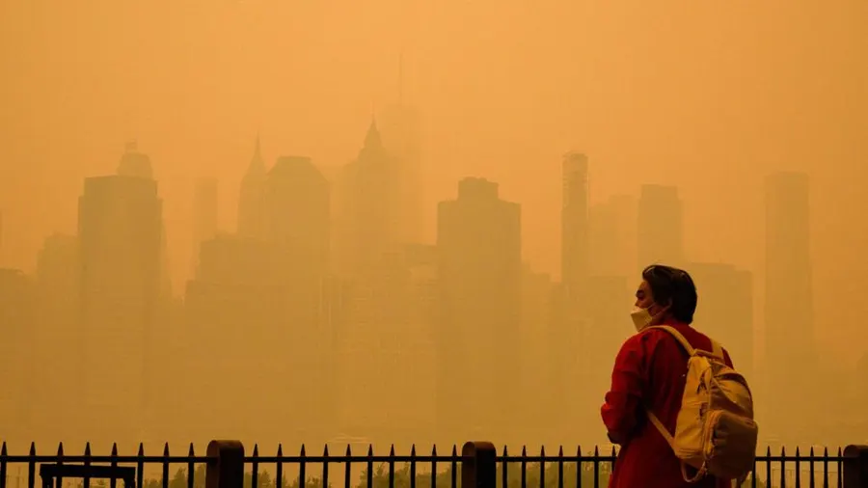
PROJECT :
Air quality monitoring -incorporating predictive modelling to forecast air quality trends on historical data

Slide 2
TITLES :
INTRODUCTION
RELATED WORKS
PRACTICAL IMPLICATIONS
CONTIBUTIONS
CONCLUSION

Slide 3
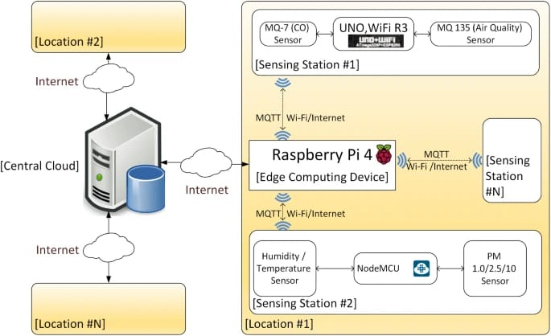
INTRODUCTION
Air pollution is regarded as a blend of particles and gases—whose concentration is higher than a recommended safety level—discharged into the atmosphere [5].
The sources of pollutants can be split into two main divisions:
Natural and anthropogenic (human-made).
Pollution of natural sources refers to natural incidents triggering destructive effects on the environment or emitting harmful substances.
Examples :
natural incidents are forest conflagrations and volcanic outbursts, generating lots of air pollutants, including SOx, NOx, Cox.
On the other hand, numerous human-made sources exist like vehicles’ emissions and fuel combustion, which are deemed one of the leading causes of air pollution.

Slide 4
RELATED WORKS :
Some of the popular approaches and related works include:
1.
MACHINE LEARNING MODELS:
Many studies have employed machine learning algorithms like Random Forest, Support Vector Machines, and Neural Networks to predict air quality. These models use historical data on factors like meteorological conditions, pollutants, and geographic information
2.
TIME SERIES FORECASTING:
Techniques such as ARIMA (AutoRegressive Integrated Moving Average) and LSTM (Long Short-Term Memory) recurrent neural networks have been used to predict air quality by considering the temporal patterns in pollutant levels.
3.
SPATIAL INTERPOLATION:
Researchers have developed spatial interpolation methods like Kriging and Inverse Distance Weighting to estimate air quality values at unmonitored locations based on measurements from nearby monitoring stations.Environmental .

Slide 5
4.
Environmental Sensors and IoT:
The use of Internet of Things (IoT) devices and environmental sensors has become increasingly popular for real-time air quality monitoring and prediction. These sensors can provide high-resolution data for accurate predictions.
5.
Deep Learning for Image Analysis:
Some studies have explored the use of deep learning models for image analysis, where satellite imagery and street-level images are analysed to predict air quality and detect sources of pollution.
6.
Hybrid Models:
Researchers often combine multiple approaches, such as integrating meteorological data with machine learning models or using a combination of sensor data and traditional modelling techniques for more accurate predictions.
7.
Air Quality Index (AQI) Prediction:
Many works focus on predicting the Air Quality Index, which provides a simplified and standardized way to communicate air quality information to the public.

Slide 6
PRATICAL IMPLICATIONS :
Practical implications for implementing the proposed systemThe proposed system will have multiple layers in terms of data flow
Full size image The layers presented in the figure above show the logical flow of transmission and processing of data by many devices and networks according to the available resources upon implementation.
The components of the system are:
1.
IoT edge devices:
a.
The IoT Sensors layer contains the sensors required in the prediction process. The sampling rate can be fixed or controlled by the IoT Edge Computing Nodes layer. This layer can get multiple readings including but not limited to: relative humidity level (%), temperature (°C), altitude (m), pressure ( hPa ), carbon monoxide CO (ppm), carbon dioxide CO2 (ppm), particulate matter of 0.3 ~ 10 µm in diameter (µg/m3), ammonium NH4 (ppm), methane CH4 (ppm), wind direction ( (°deg ), wind speed (m/s), detected Wi-Fi networks, and their signal strength in decibels

Slide 7
2.
IoT Edge devices layer comprises:
i.
Wired sensors transmit data through numerous methods, such as (Inter-Integrated Circuits—I2C, Serial Peripheral Interface—SPI, and Universal Asynchronous Receiver/Transmitter—UART) to the next layer.
ii.
Wireless sensors in which data are sent via wireless protocols (ZigBee/Z-Wave). Data could be carried using MQTT over Zigbee protocol called (MQTT-SN).
b.
IoT edge computing nodes:
Here smart edge devices can be used to process collected data and send either a summary or a stream of the current readings to the cloud or perform the required local prediction directly using the computing power available to them.
Example of these nodes is SBCs, Arduinos, and Arduino-compatible devices.

Slide 8
2.
IoT network/internet:
Communication between IoT Edge Devices and the IoT cloud is carried through this layer. First, IoT gateways coordinate between various IoT Edge nodes in terms of network usage and cooperation.
For example, SBCs from the previous layer could be used as IoT gateways.
Then, the connections are relayed to the cloud via many possible network facilities, such as mobile technologies (2G-3G-4G-5G-Narrowband IoT), Low-Power Wide Area Network (LPWAN) technologies including (Long-Range Wide Area Network (LoRaWAN) and Sigfox) or Wi-Fi.
Finally, it is required to provide secure and reliable linkage to the IoT Cloud layer with good coverage across the area to be monitored.
3.
IoT cloud:
All data collected from various stations in the system are processed in this part of the data flow.
This part could be optional if the prediction is entirely made on the edge devices.
However, for a bigger picture and more accurate results, central management and processing add higher value.

Slide 9
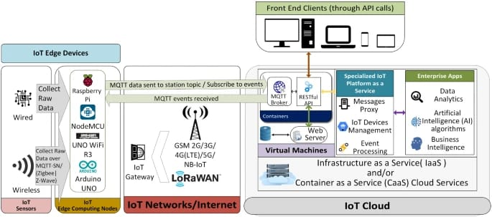
PRACTICAL IMPLICATIONS

Slide 10
CONTRIBUTION :
AQI history can be analysed with real-time data collected from IoT-enabled devices.
Additionally, exploratory analysis is conducted to gain further insight into the dataset.
In contrast to prior investigations that focused on a few forecasting methodologies, multiple time-series forecasting methods have been used to predict air quality.
AQI history can be analysed with real-time data collected from IoT-enabled devices.
Additionally, exploratory analysis is conducted to gain further insight into the dataset.
Some advanced forecasting models also have been applied, such as Prophet, LSTM, and extreme Gradient Boosting.
To enhance AQI prediction accuracy, we proposed a BO-HyTS approach that combines SARIMA and LSTM is introduced and fine-tuned using Bayesian optimization to improve forecasting accuracy.
Various accuracy measurement techniques have been used to compare the results, including MSE, RMSE, Med AE, Max error, and MAE.

Slide 11
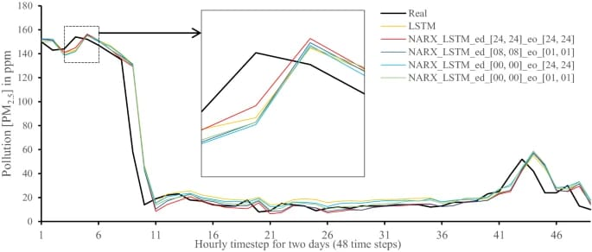
REAL VS PREDICTION FOR THE PROPOSED NARX HYBRID AND LSTM RUN ON PC

Slide 12
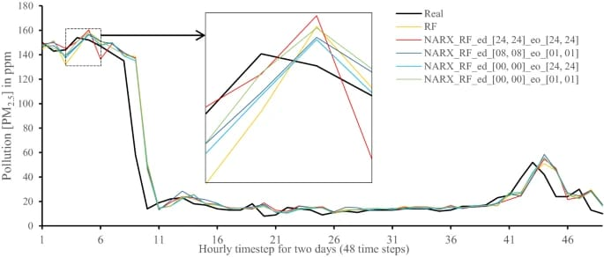
REAL VS PREDICTION FOR THE PROPOSED NARX HYBRID AND RANDOM FORESTS RUN ON PC

Slide 13
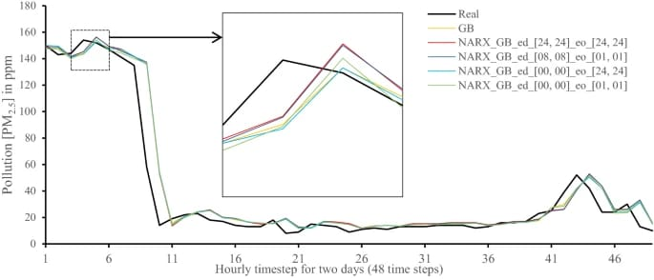
REAL VS. PREDICTION FOR THE PROPOSED NARX HYBRID AND GRADIENT BOOST RUN ON PC

Slide 14
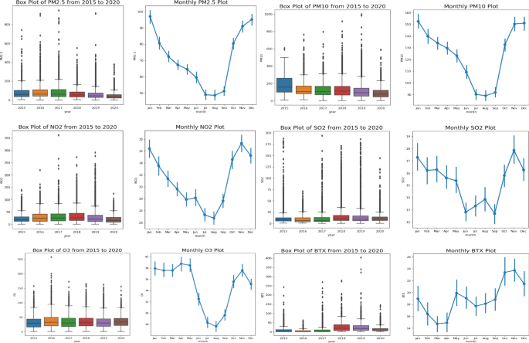
CONCLUSION :
In this Slide, we use the Light GBM model to process the
high-dimensional data to predict the PM2.5 concentration in the 24 hours based on the historical datasets and predictive datasets.
We proposed a predictive data feature exploration-based air quality prediction approach.
The approach enables to deeply mine and explore the high-dimensional time-related features and statistical features based on the exploratory analysis of big data.

Slide 15
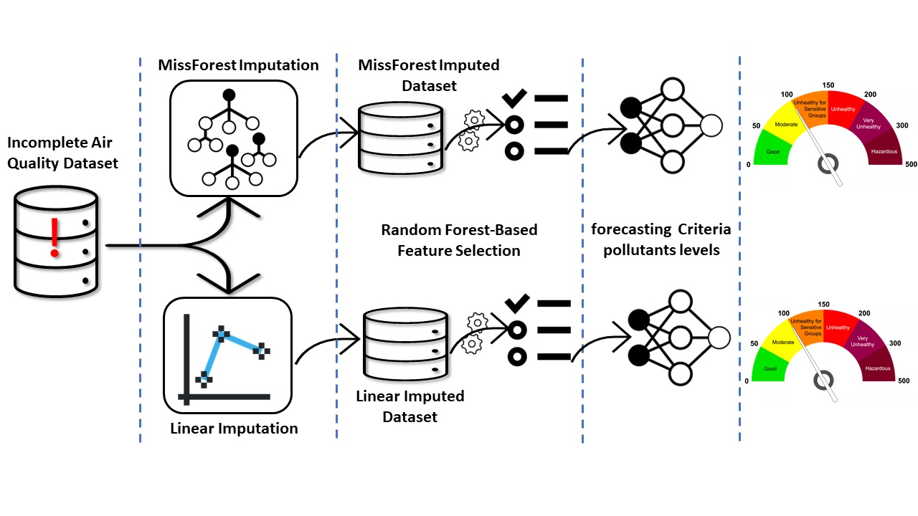

Slide 16
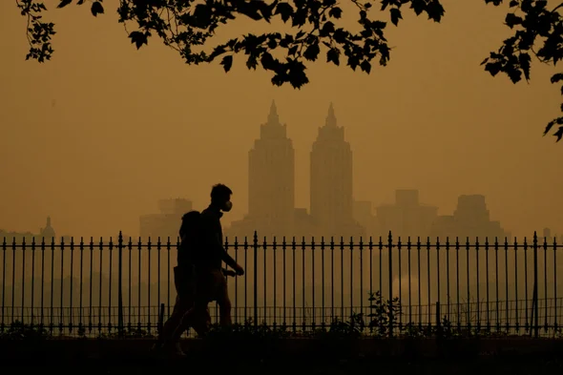
THANK YOU
These are the predictive modelling to forecast air quality trends on historical data.(PHASE-2)
BY
MOHAMED ASHRAF ALI M
422621104026
UNIVERSITY COLLEGE OF ENGINEERING

